Slide 1
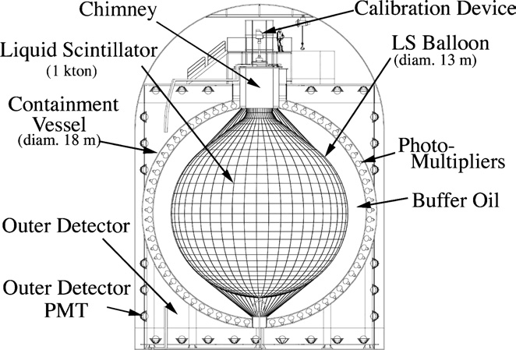
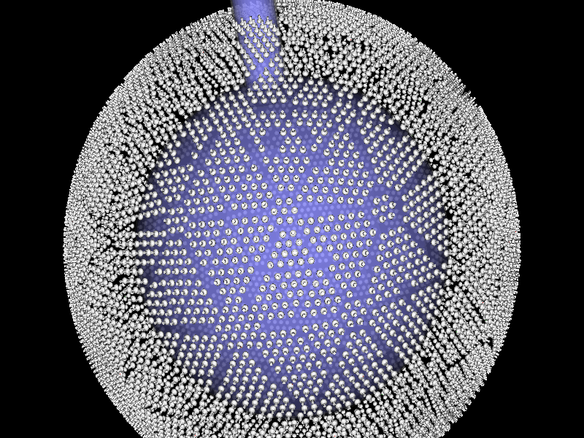
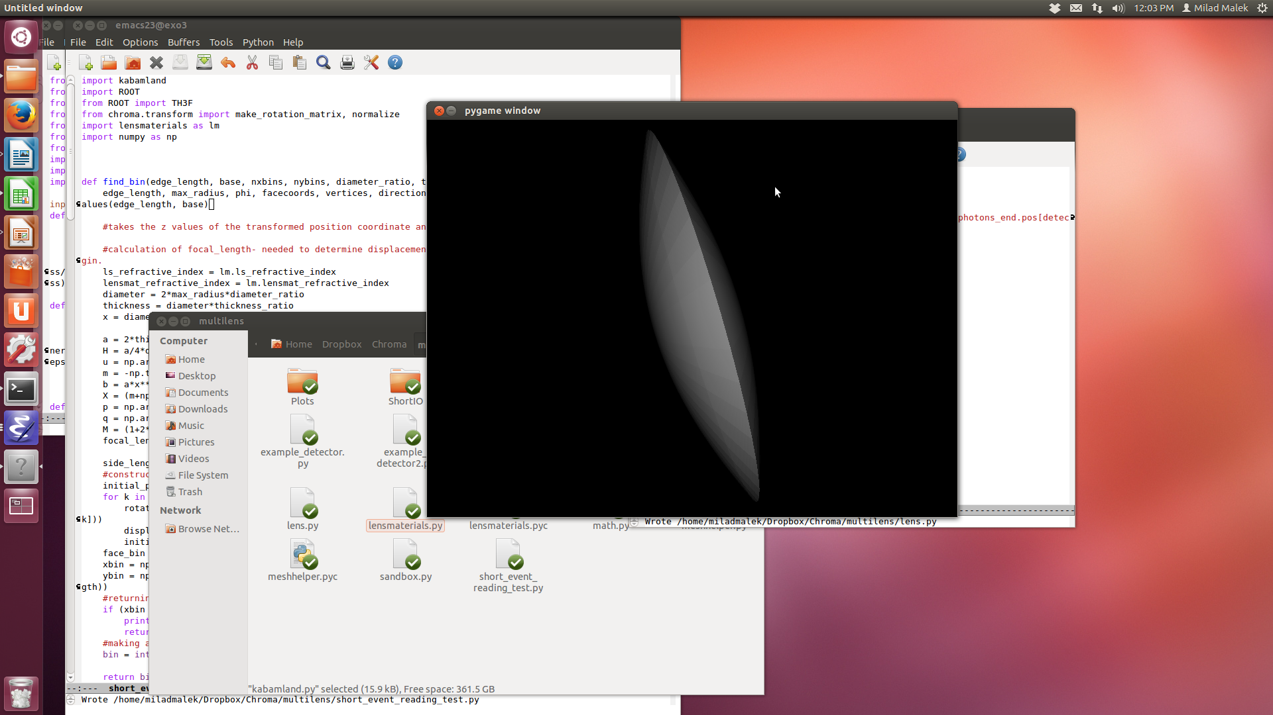
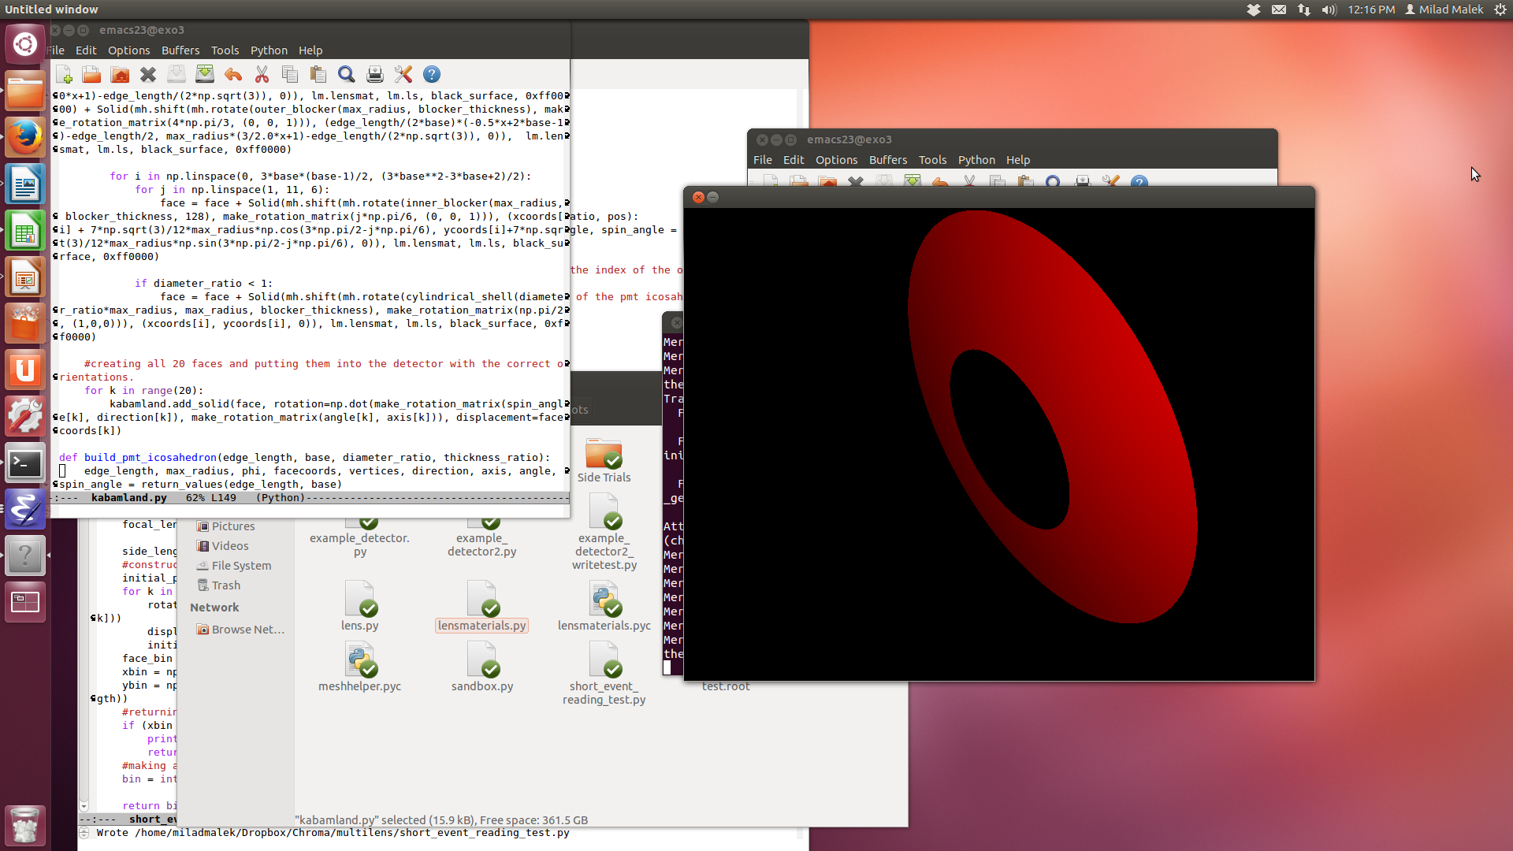
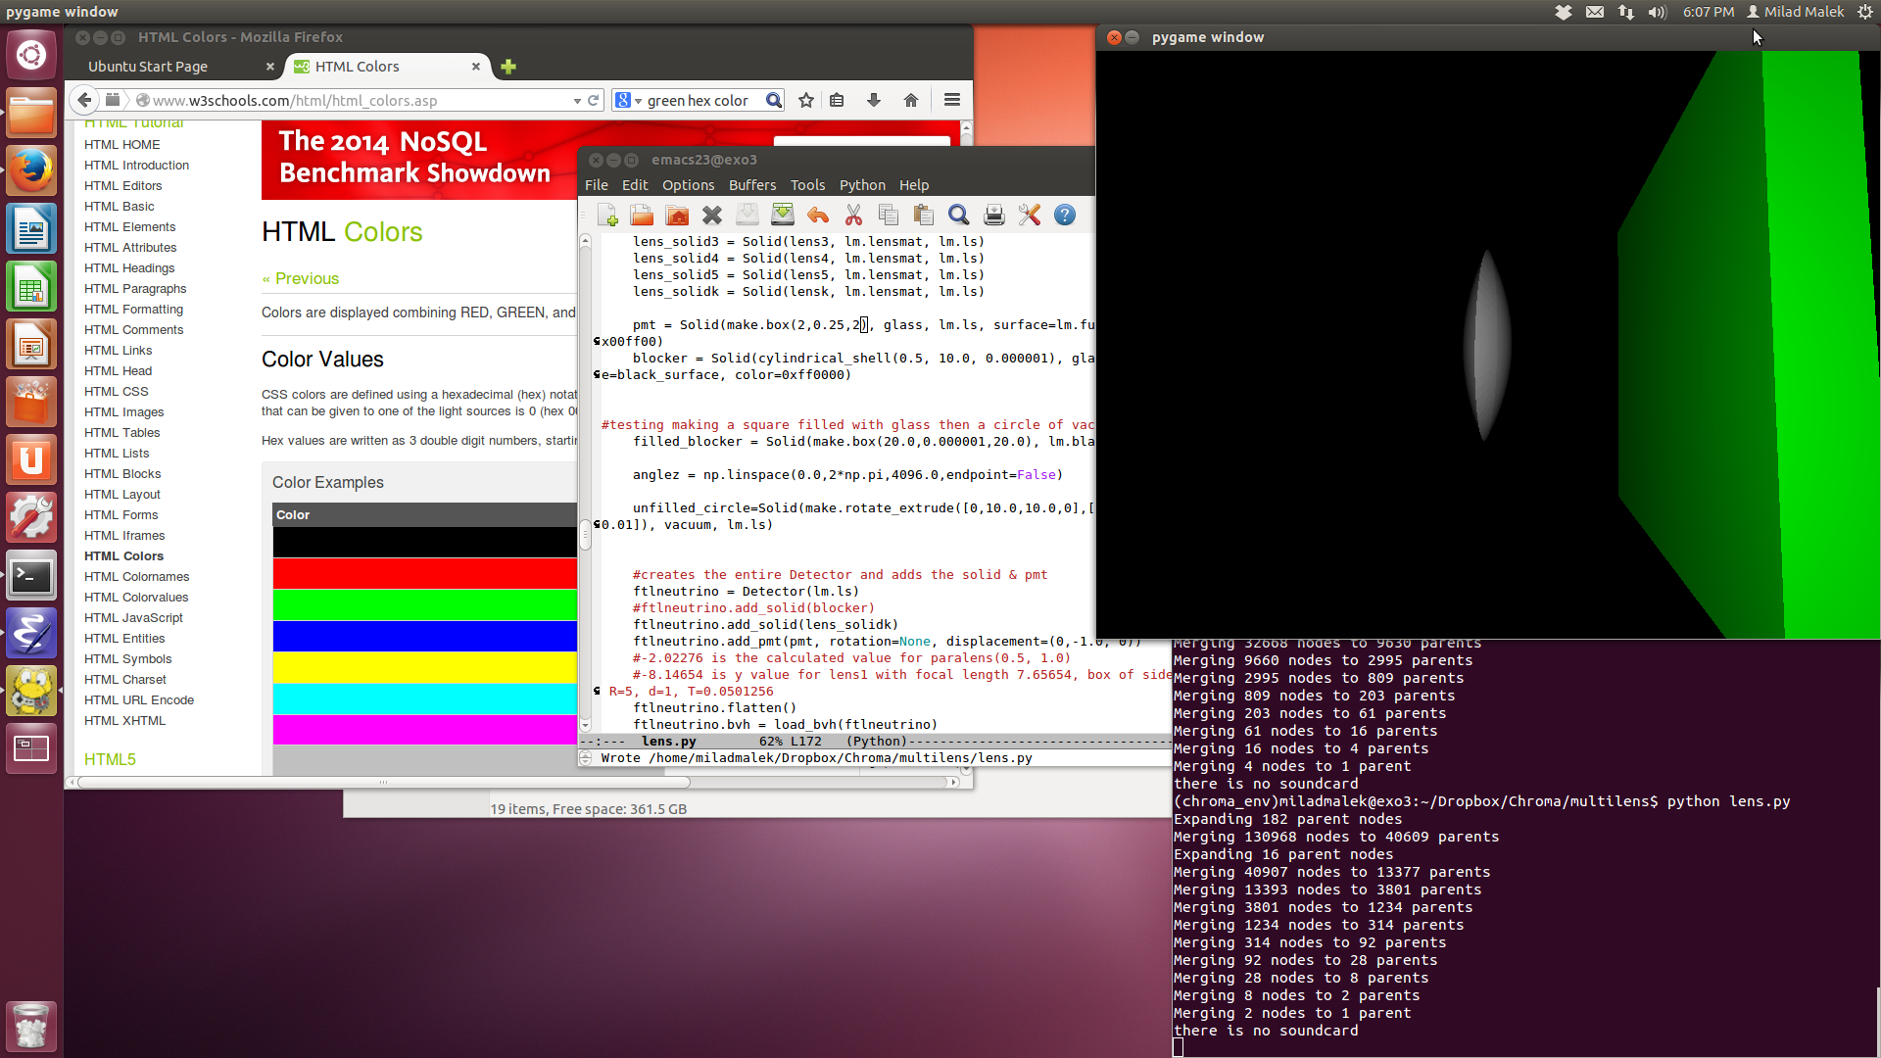
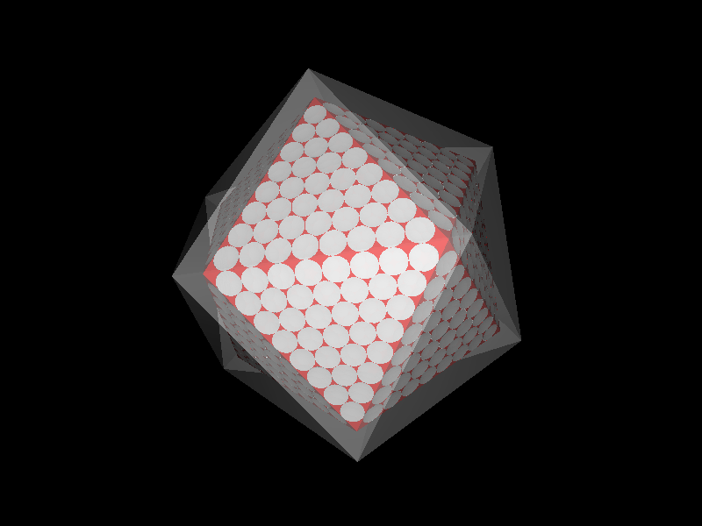
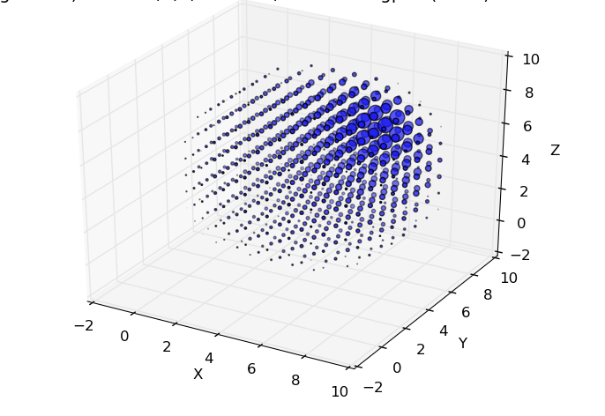
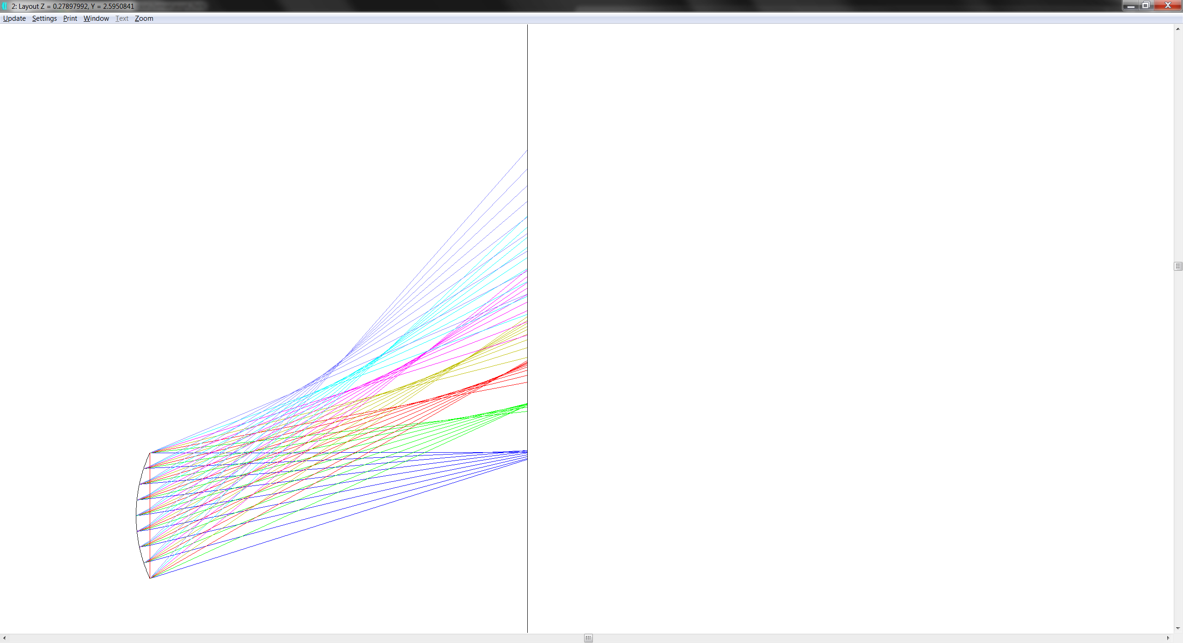
Simulating Multilens Scintillation Detector with Chroma
Milad Malek, Scott Kravitz Advisor: Prof. Giorgio Gratta
Contact Info: Milad Malek, m3malek@stanford.edu
Scott Kravitz, skravitz@stanford.edu
Goal
Scintillation detectors like KamLAND have timing info, but limited position reconstruction
Addition of directional info could allow for better information on where events take place within the detector.
Lenses and Directional Info
Our approach is to place lenses around the perimeter of the detector to map angle of incidence to a position along the photodetector array.
Chroma
Chroma uses parallel processing power of GPUs to do fast ray tracing computations
Designed by particle physicists for rapid simulation of optical photons in detectors
Chroma’s Capabilities
Create arbitrary objects with given optical properties
Editable properties include:
refractive index
absorption length
scattering length
To right: Lens and Blocker Objects built in Chroma
Simulations
Photons and particles can be simulated rapidly with specified properties such as positions and directions.
We can simulate up to and even over 1 billion photons at a time.
Full Detector Geometry
Regular icosahedron with alterable amount and shapes of lenses.
Photodetecting surface outside the lenses (transparent in photo)
Event
Lens
Detector
Analysis
Bin the Photodetecting surface into detector pixels.
Create a probability density function (PDF) for each pixel indicating the likelihood that photons from each position within the detector will reach it.
Then, after simulation of an event from a single location, simply add and/or multiply the PDFs of each pixel by the amount of photons it received in order to determine where the event took place.
Current Goals
Use Zemax ray-tracing software to create lens that will focus light properly for all incident angles onto the image plane.
Tune the parameters of the detector to create the best spatial reconstruction of events.
Allow for reconstruction of multiple simultaneous events.
Notes:
<number>

